Slide 1
Graph Algorithms-II
Topological Sorting and Strongly connected Components

Slide 2
Topological Sort (An application of DFS)

Slide 3
Topological sort
We have a set of tasks and a set of dependencies (precedence constraints) of form “task A must be done before task B”
Topological sort: An ordering of the tasks that conforms with the given dependencies
Goal: Find a topological sort of the tasks or decide that there is no such ordering

Slide 4
Topological sort more formally
Suppose that in a directed graph G = (V, E) vertices V represent tasks, and each edge (u, v)∊E means that task u must be done before task v
What is an ordering of vertices 1, ..., |V| such that for every edge (u, v), u appears before v in the ordering?
Such an ordering is called a topological sort of G
Note: there can be multiple topological sorts of G

Slide 5
Topological sort more formally
Is it possible to execute all the tasks in G in an order that respects all the precedence requirements given by the graph edges?
The answer is "yes" if and only if the directed graph G has no cycle!
(otherwise we have a deadlock)
Such a G is called a Directed Acyclic Graph, or just a DAG

Slide 6
Directed Acyclic Graph
DAG – Directed graph with no cycles.
Eg:
socks
shorts
T-shirt
batting glove
hose
chest pad
pants
sweater
skates
mask
leg pads
catch glove
DAG of dependencies for putting on goalie equipment.
blocker

Slide 7
DAGs and back edges
Can there be a back edge in a DFS on a DAG?
NO! Back edges close a cycle!
A graph G is a DAG <=> there is no back edge classified by DFS(G)

Slide 8
Topological Sort
Performed on a DAG.
Linear ordering of the vertices of G such that if (u, v) ∈ E, then u appears somewhere before v.
Topological-Sort (G)
call DFS(G) to compute finishing times f [v] for all v ∈ V
as each vertex is finished, insert it onto the front of a linked list
return the linked list of vertices
Time: Θ(V + E).

Slide 9
Topological sort
Call DFS(G) to compute the finishing times f[v]
Time = 1
Time = 2
d = ∞
f = ∞
Let’s say we start the DFS from the vertex c
a
d = ∞
f = ∞
Next we discover the vertex d
d = ∞
f = ∞
d = 1
f = ∞
b
c
c
d = ∞
f = ∞
d = ∞
f = ∞
d
e
d = ∞
f = ∞
f

Slide 10
Topological sort
Call DFS(G) to compute the finishing times f[v]
Time = 2
Time = 3
d = ∞
f = ∞
Let’s say we start the DFS from the vertex c
a
d = 1
f = ∞
Next we discover the vertex d
d = ∞
f = ∞
b
c
c
d = ∞
f = ∞
d = ∞
f = ∞
d = 2
f = ∞
d
d
e
d = ∞
f = ∞
f

Slide 11
Topological sort
Call DFS(G) to compute the finishing times f[v]
Time = 3
Time = 4
as each vertex is finished, insert it onto the front of a linked list
d = ∞
f = ∞
Let’s say we start the DFS from the vertex c
a
d = 1
f = ∞
Next we discover the vertex d
d = ∞
f = ∞
b
c
c
Next we discover the vertex f
d = 2
f = ∞
d = ∞
f = ∞
f is done, move back to d
d
d
e
d = 3
f = ∞
d = 3
f = 4
f
f
f

Slide 12
Topological sort
Call DFS(G) to compute the finishing times f[v]
Time = 4
Time = 5
d = ∞
f = ∞
Let’s say we start the DFS from the vertex c
a
d = 1
f = ∞
Next we discover the vertex d
d = ∞
f = ∞
b
c
c
Next we discover the vertex f
d = 2
f = 5
d = ∞
f = ∞
f is done, move back to d
d
d
e
d is done, move back to c
d = 3
f = 4
f
f
d
f

Slide 13
Topological sort
Call DFS(G) to compute the finishing times f[v]
Time = 5
Time = 6
d = ∞
f = ∞
Let’s say we start the DFS from the vertex c
a
d = 1
f = ∞
Next we discover the vertex d
d = ∞
f = ∞
b
c
c
Next we discover the vertex f
d = 2
f = 5
d = ∞
f = ∞
f is done, move back to d
d
d
e
d is done, move back to c
d = 3
f = 4
f
Next we discover the vertex e
f
d
f

Slide 14
Topological sort
Call DFS(G) to compute the finishing times f[v]
Time = 6
Time = 7
d = ∞
f = ∞
Let’s say we start the DFS from the vertex c
a
d = 1
f = ∞
Next we discover the vertex d
d = ∞
f = ∞
b
c
Next we discover the vertex f
Both edges from e are cross edges
d = 2
f = 5
d = 6
f = ∞
f is done, move back to d
d
d
e
e
d is done, move back to c
d = 3
f = 4
f
Next we discover the vertex e
f
e is done, move back to c
e
d
f

Slide 15
Topological sort
Call DFS(G) to compute the finishing times f[v]
Time = 7
Time = 8
d = ∞
f = ∞
Let’s say we start the DFS from the vertex c
a
Just a note: If there was (c,f) edge in the graph, it would be classified as a forward edge
(in this particular DFS run)
d = 1
f = ∞
Next we discover the vertex d
d = ∞
f = ∞
b
c
Next we discover the vertex f
d = 2
f = 5
d = 6
f = 7
f is done, move back to d
d
d
e
e
d is done, move back to c
d = 3
f = 4
f
Next we discover the vertex e
f
e is done, move back to c
c
e
d
f
c is done as well

Slide 16
Topological sort
Call DFS(G) to compute the finishing times f[v]
Time = 9
Time = 10
d = ∞
f = ∞
Let’s now call DFS visit from the vertex a
d = 9
f = ∞
a
a
d = 1
f = 8
Next we discover the vertex c,
but c was already processed => (a,c) is a cross edge
d = ∞
f = ∞
b
c
d = 2
f = 5
d = 6
f = 7
Next we discover the vertex b
d
d
e
e
d = 3
f = 4
f
f
c
e
d
f

Slide 17
Topological sort
Call DFS(G) to compute the finishing times f[v]
Time = 10
Time = 11
d = 9
f = ∞
Let’s now call DFS visit from the vertex a
a
a
d = 1
f = 8
Next we discover the vertex c,
but c was already processed => (a,c) is a cross edge
d = 10
f = ∞
d = 10
f = 11
b
b
c
d = 2
f = 5
d = 6
f = 7
Next we discover the vertex b
d
d
e
e
b is done as (b,d) is a cross edge => now move back to c
d = 3
f = 4
f
f
b
c
e
d
f

Slide 18
Topological sort
Call DFS(G) to compute the finishing times f[v]
Time = 11
Time = 12
d = 9
f = ∞
Let’s now call DFS visit from the vertex a
a
a
d = 1
f = 8
Next we discover the vertex c,
but c was already processed => (a,c) is a cross edge
d = 10
f = 11
b
b
c
d = 2
f = 5
d = 6
f = 7
Next we discover the vertex b
d
d
e
e
b is done as (b,d) is a cross edge => now move back to c
d = 3
f = 4
f
f
a is done as well
b
c
e
d
f

Slide 19
Topological sort
Call DFS(G) to compute the finishing times f[v]
Time = 11
Time = 13
d = 9
f = 12
Let’s now call DFS visit from the vertex a
WE HAVE THE RESULT!
return the linked list of vertices
a
a
d = 1
f = 8
Next we discover the vertex c,
but c was already processed => (a,c) is a cross edge
d = 10
f = 11
b
b
c
d = 2
f = 5
d = 6
f = 7
Next we discover the vertex b
d
d
e
e
b is done as (b,d) is a cross edge => now move back to c
d = 3
f = 4
f
f
a is done as well
a
b
c
e
d
f

Slide 20
Topological sort
Time = 11
Time = 13
The linked list is sorted in decreasing order of finishing times f[]
d = 9
f = 12
a
a
d = 10
f = 11
d = 1
f = 8
b
Try yourself with different vertex order for DFS visit
b
c
d = 2
f = 5
d = 6
f = 7
d
d
e
e
Note: If you redraw the graph so that all vertices are in a line ordered by a valid topological sort, then all edges point „from left to right“
d = 3
f = 4
f
f
a
b
c
e
d
f

Slide 21
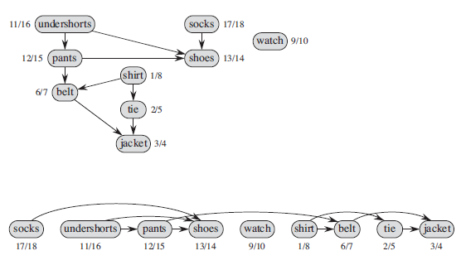
TS(G)Example:2

Slide 22
Time complexity of TS(G)
Running time of topological sort:
Θ(n + m) where n=|V| and m=|E|
Why? Depth first search takes Θ(n + m) time in the worst case, and inserting into the front of a linked list takes Θ(1) time

Slide 23
Example:3
A
B
D
1/
C
E
Linked List:

Slide 24
Example
A
B
D
1/
2/
C
E
Linked List:

Slide 25
Example
A
B
D
1/
2/3
C
E
Linked List:
2/3
E

Slide 26
Example
A
B
D
1/4
2/3
C
E
Linked List:
1/4
2/3
D
E

Slide 27
Example
A
B
D
5/
1/4
2/3
C
E
Linked List:
1/4
2/3
D
E

Slide 28
Example
A
B
D
5/
1/4
6/
2/3
C
E
Linked List:
1/4
2/3
D
E

Slide 29
Example
A
B
D
5/
1/4
6/7
2/3
C
E
Linked List:
6/7
1/4
2/3
C
D
E

Slide 30
Example
A
B
D
5/8
1/4
6/7
2/3
C
E
Linked List:
5/8
6/7
1/4
2/3
B
C
D
E

Slide 31
Example
A
B
D
9/
5/8
1/4
6/7
2/3
C
E
Linked List:
5/8
6/7
1/4
2/3
B
C
D
E

Slide 32
Example
A
B
D
9/10
5/8
1/4
6/7
2/3
C
E
Linked List:
9/10
5/8
6/7
1/4
2/3
A
B
C
D
E

Slide 33
Strongly Connected Components
G is strongly connected if every pair (u, v) of vertices in G is reachable from one another.
A strongly connected component (SCC) of G is a maximal set of vertices C ⊆ V such that for all u, v ∈ C, both u v and v u exist.

Slide 34
Strongly Connected Components
Definition: a strongly connected component (SCC) of a directed graph G=(V,E) is a maximal set of vertices U⊆ V such that
For each u,v ∈U we have both u  v and v  u
i.e., u and v are mutually reachable from each other (u ⭾ v)
Let G^{T}=(V,E^{T}) be the transpose of G=(V,E) where
E^{T} ={(u,v): (u,v) ∈ E}
i.e., E^{T} consists of edges of G with their directions reversed
Constructing G^{T} from G takes O(V+E) time (adjacency list rep)
Note: G and G^{T} have the same SCCs (u ⭾ v in G⇔ u ⭾ v in G^{T})

Slide 35
Transpose of a Directed Graph
G^{T} = transpose of directed G.
G^{T} = (V, E^{T}), E^{T} = {(u, v) : (v, u) ∈ E}.
G^{T} is G with all edges reversed.
Can create G^{T} in Θ(V + E) time if using adjacency lists.
G and G^{T} have the same SCC’s. (u and v are reachable from each other in G if and only if reachable from each other in G^{T}.)

Slide 36
Algorithm to determine SCCs
SCC(G)
call DFS(G) to compute finishing times f [u] for all u
compute G^{T}
call DFS(G^{T}), but in the main loop, consider vertices in order of decreasing f [u] (as computed in first DFS)
output the vertices in each tree of the depth-first forest formed in second DFS as a separate SCC
Time: Θ(V + E).

Slide 37
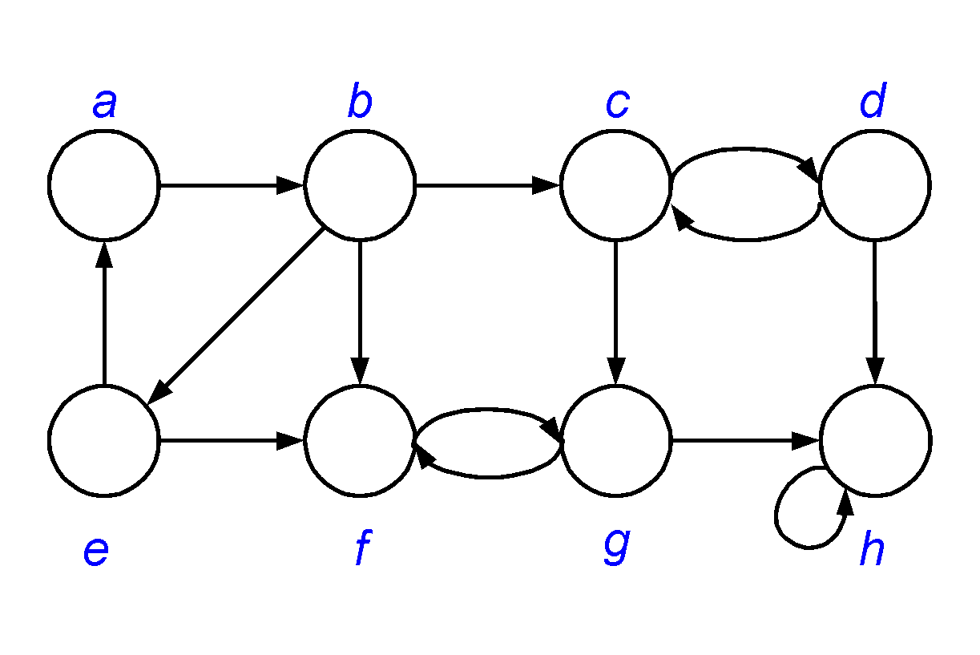
SCC: Example

Slide 38
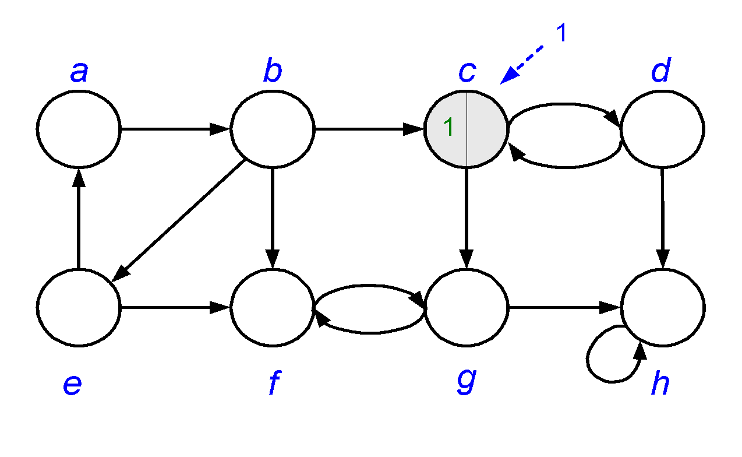
SCC: Example
Run DFS(G) to compute finishing times for all u∈V

Slide 39
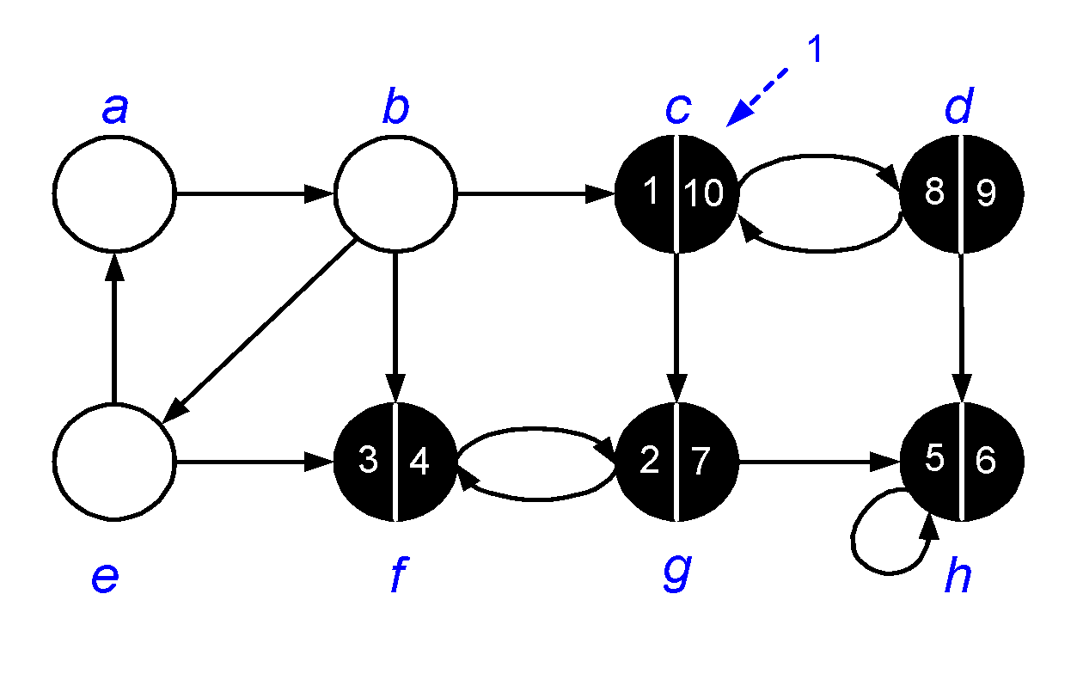
SCC: Example
Run DFS(G) to compute finishing times for all u∈V

Slide 40
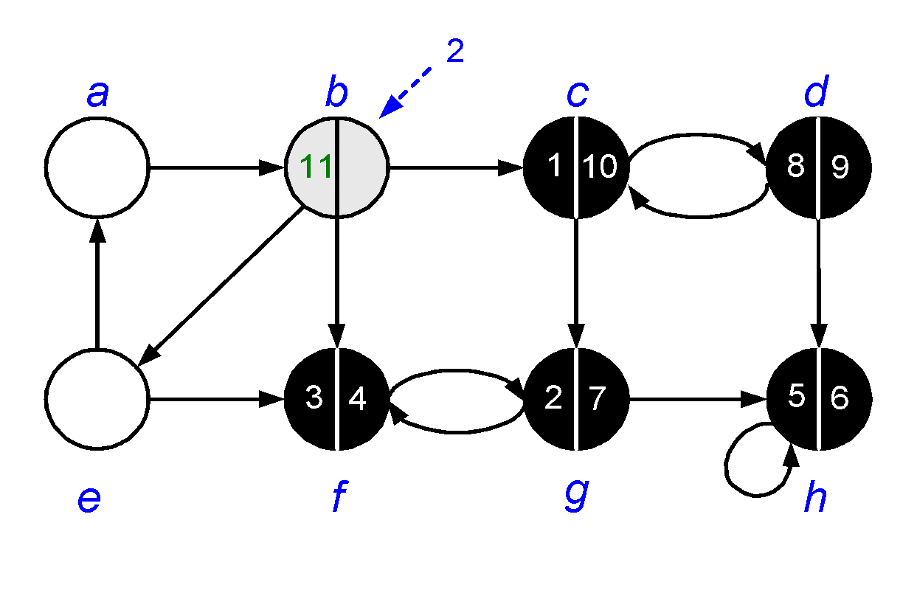
SCC: Example
Run DFS(G) to compute finishing times for all u∈V

Slide 41
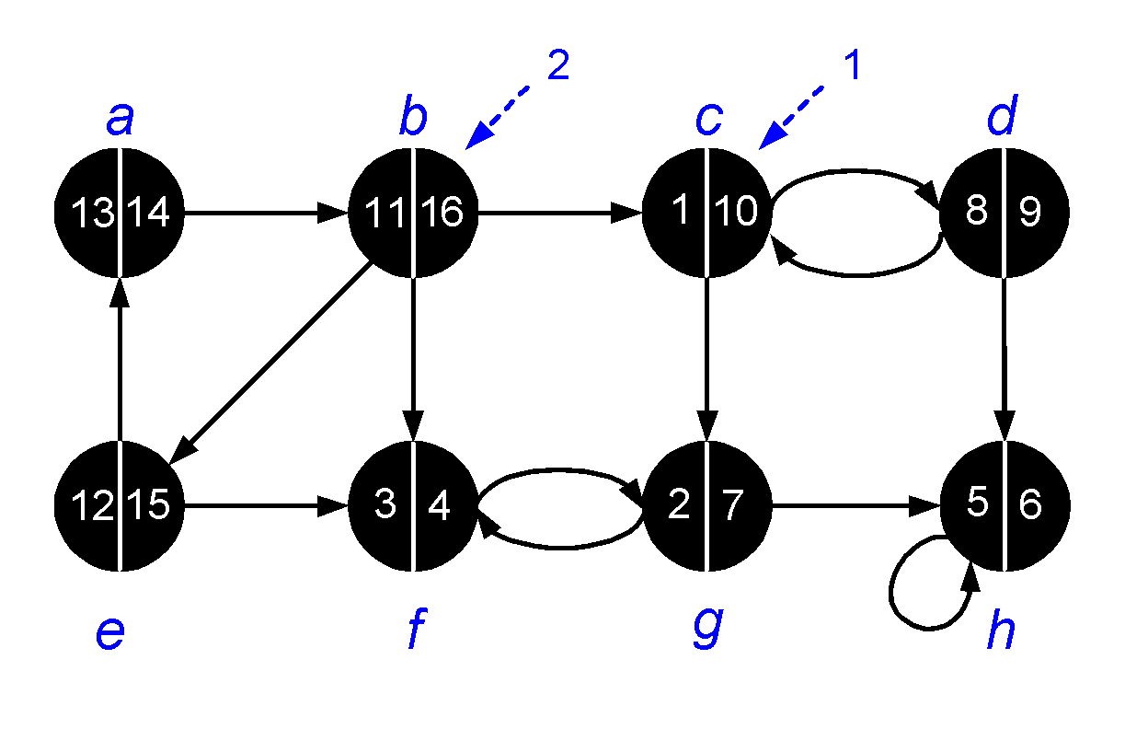
SCC: Example
Vertices sorted according to the finishing times:
〈b, e, a, c, d, g, h, f 〉

Slide 42
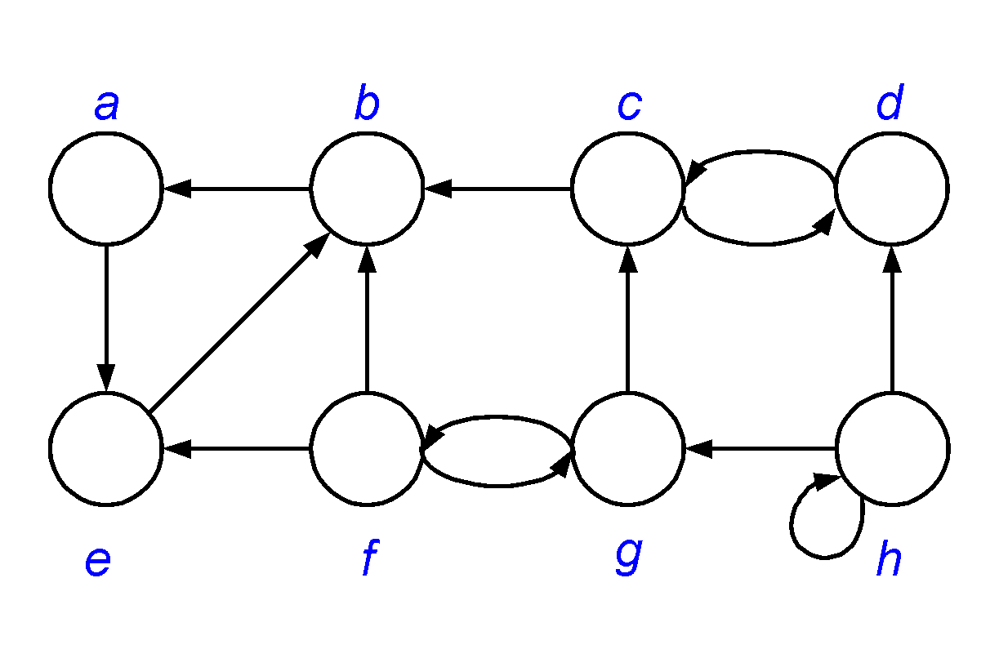
SCC: Example
Compute G^{T}

Slide 43
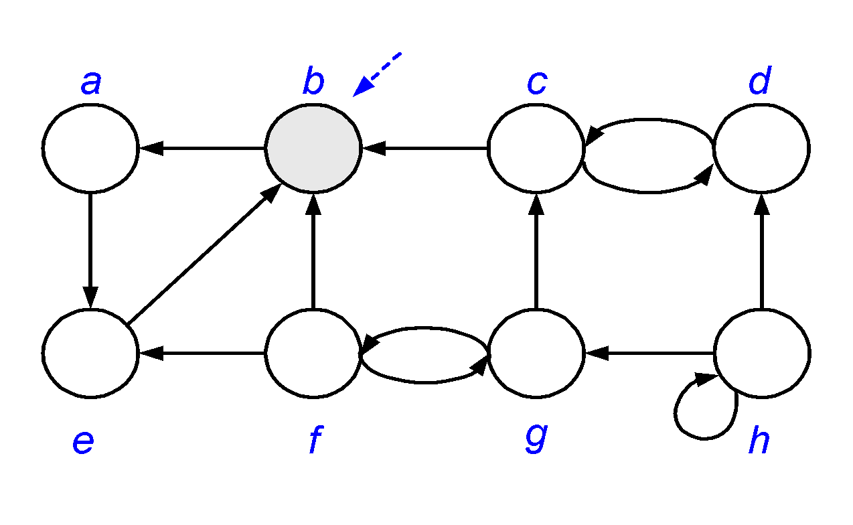
SCC: Example
(3) Call DFS(G^{T}) processing vertices in main loop in decreasing f[u] order: 〈b, e, a, c, d, g, h, f 〉

Slide 44
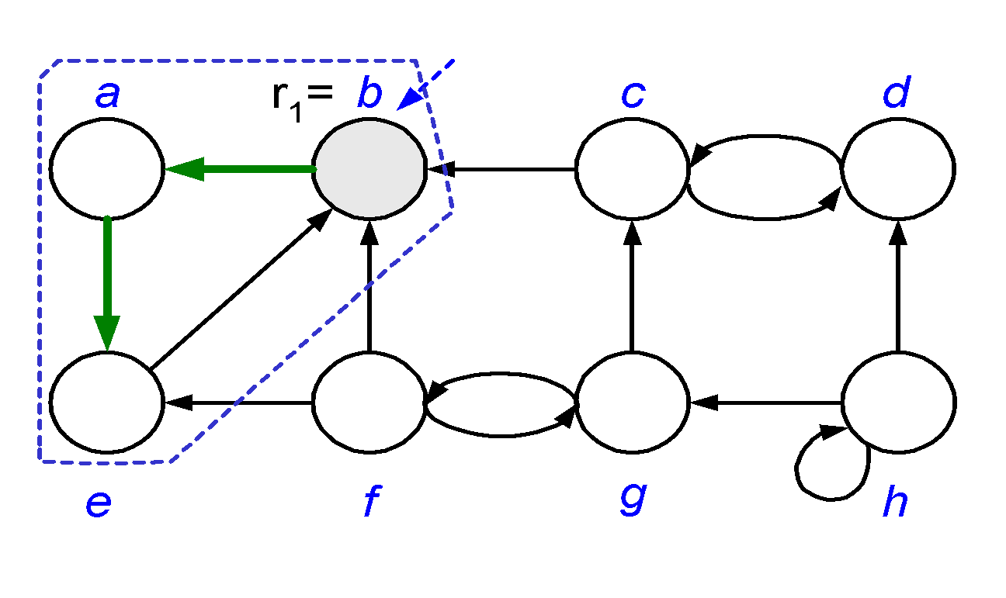
SCC: Example
(3) Call DFS(G^{T}) processing vertices in main loop in decreasing f[u] order: 〈b, e, a, c, d, g, h, f 〉

Slide 45
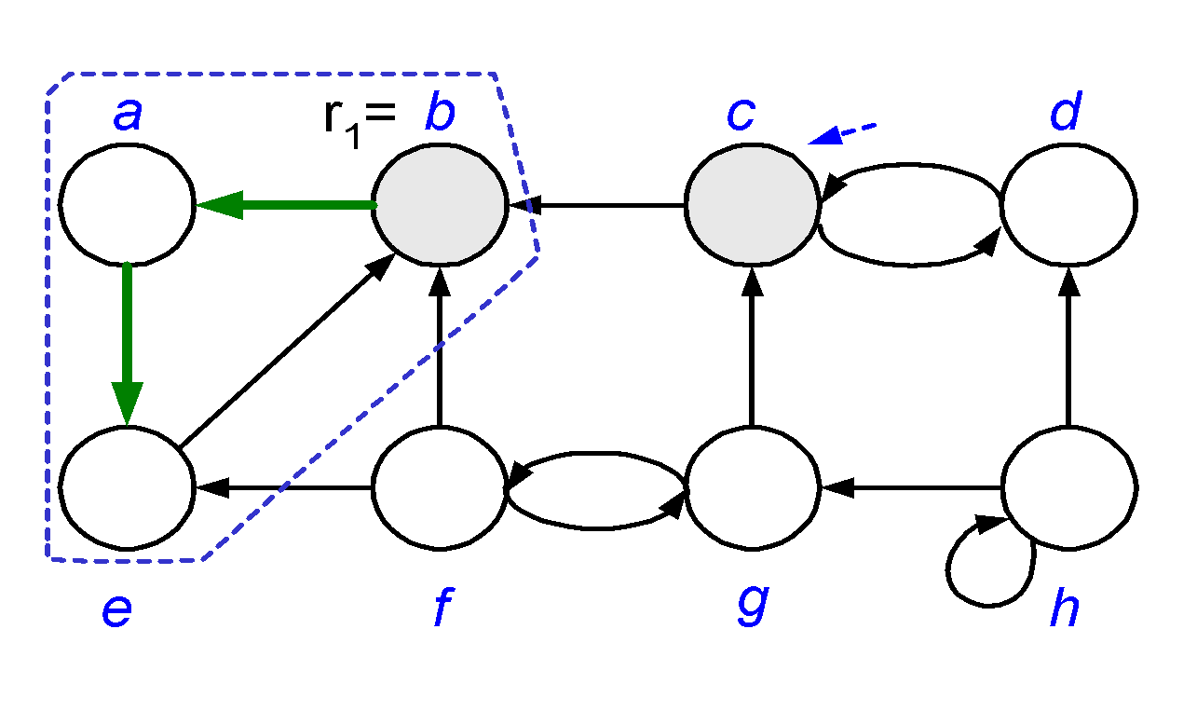
SCC: Example
(3) Call DFS(G^{T}) processing vertices in main loop in decreasing f[u] order: 〈b, e, a, c, d, g, h, f 〉

Slide 46
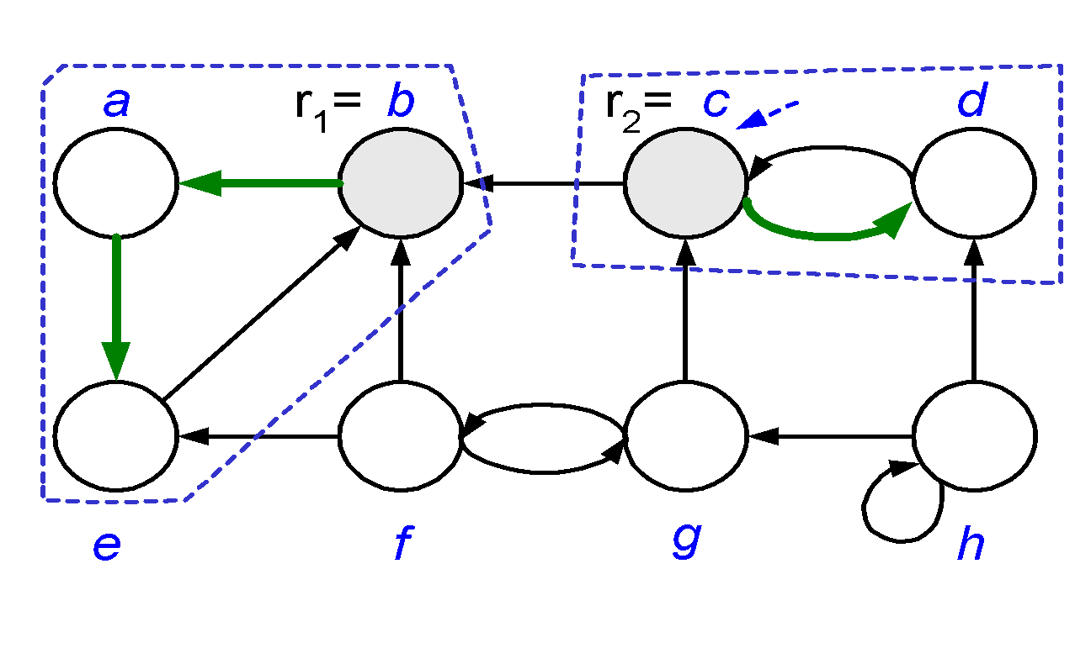
SCC: Example
(3) Call DFS(G^{T}) processing vertices in main loop in decreasing f[u] order: 〈b, e, a, c, d, g, h, f 〉

Slide 47
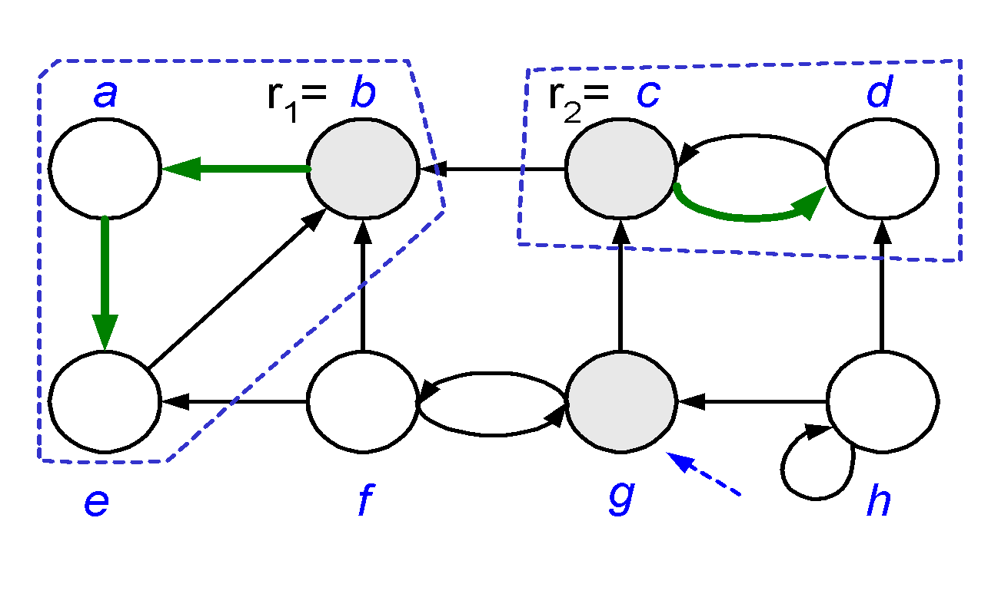
SCC: Example
(3) Call DFS(G^{T}) processing vertices in main loop in decreasing f[u] order: 〈b, e, a, c, d, g, h, f 〉

Slide 48
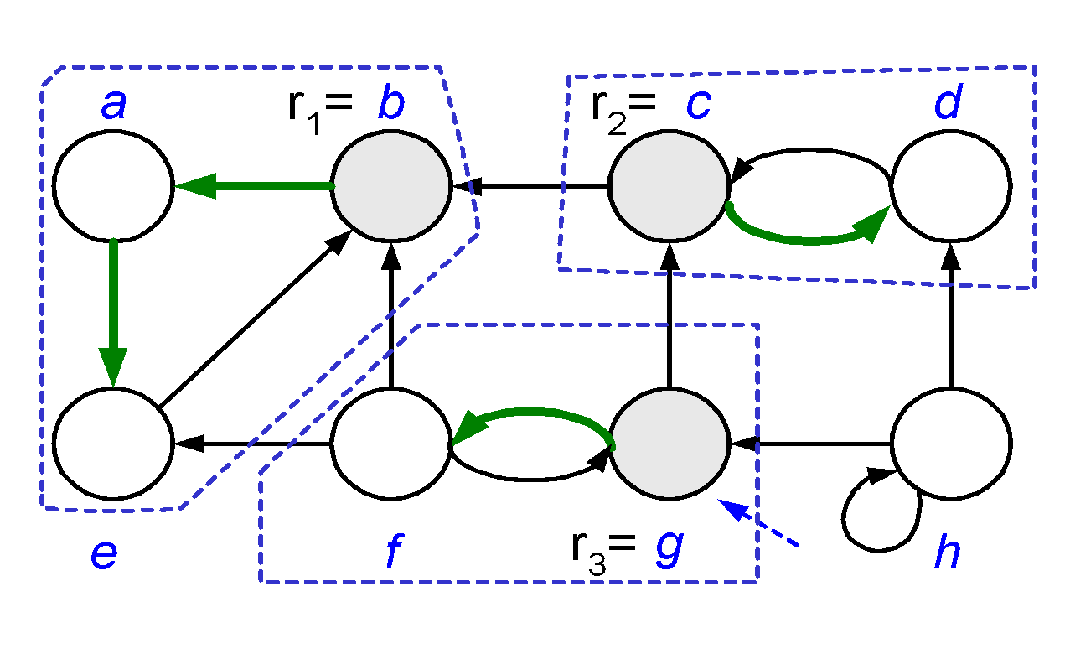
SCC: Example
(3) Call DFS(G^{T}) processing vertices in main loop in decreasing f[u] order: 〈b, e, a, c, d, g, h, f 〉

Slide 49
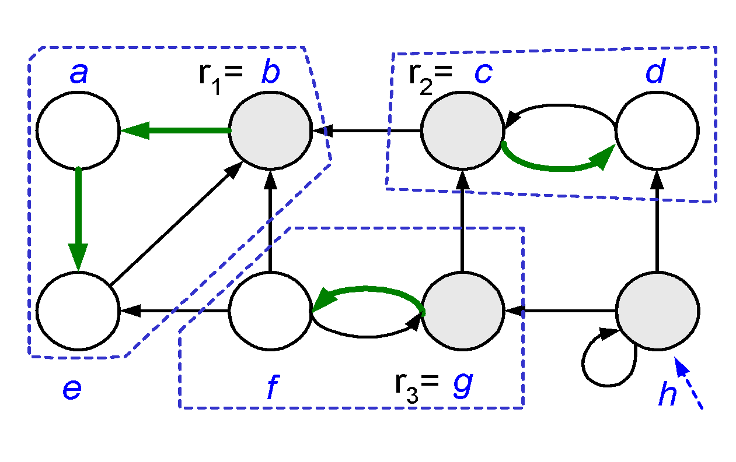
SCC: Example
(3) Call DFS(G^{T}) processing vertices in main loop in decreasing f[u] order: 〈b, e, a, c, d, g, h, f 〉

Slide 50
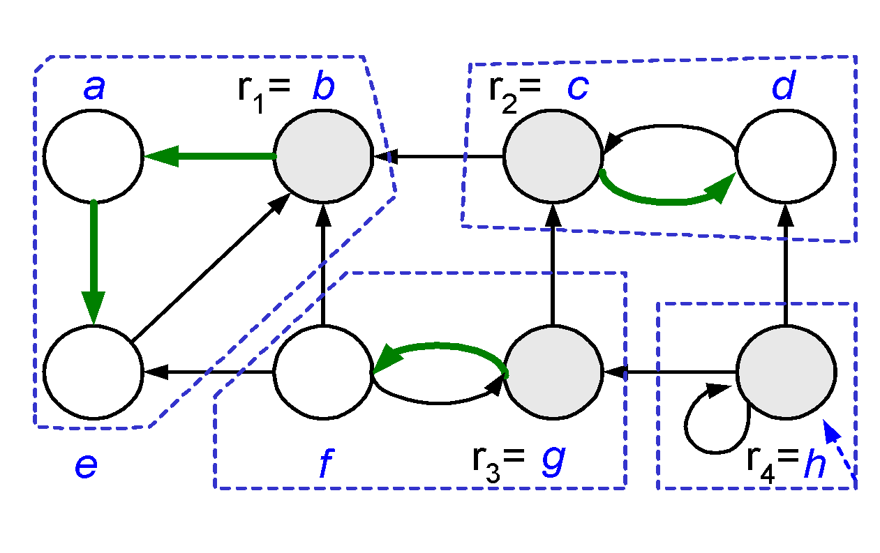
SCC: Example
(3) Call DFS(G^{T}) processing vertices in main loop in decreasing f[u] order: 〈b, e, a, c, d, g, h, f 〉

Slide 51

SCC: Example
(4) Output vertices of each DFT in DFF as a separate SCC
C_{c}={c,d}
C_{b}={b,a,e}
C_{g}={g,f}
C_{h}={h}

Slide 52
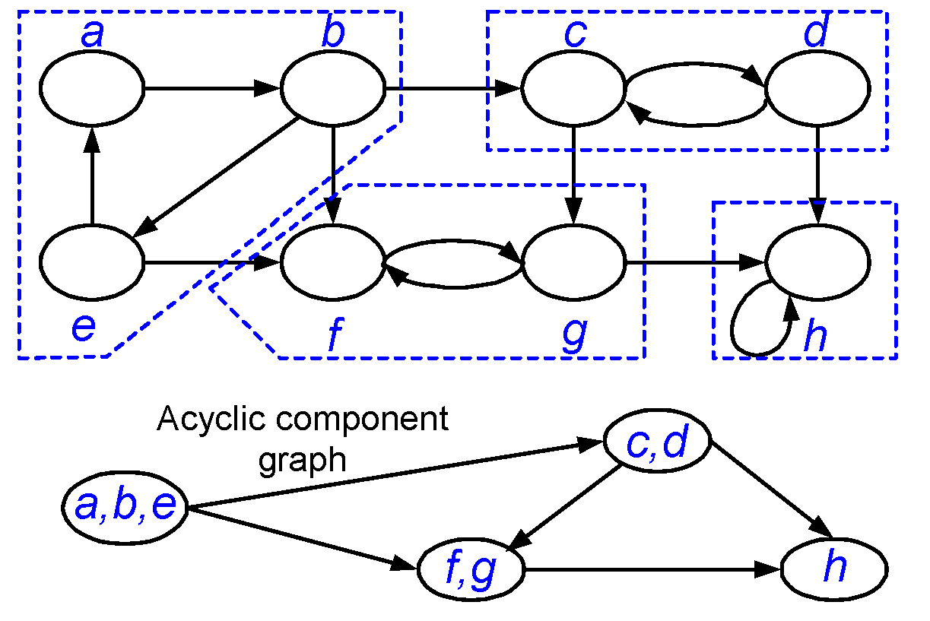
SCC: Example
C_{c}
C_{b}
C_{g}
C_{h}

Slide 53
How does it work?
Idea:
By considering vertices in second DFS in decreasing order of finishing times from first DFS, we are visiting vertices of the component graph in topologically sorted order.
Because we are running DFS on G^{T}, we will not be visiting any v from a u, where v and u are in different components.

